Slide 1

Exoplanets: Transiting Light Curve Fitting
Everett Helm & Ember Boicey

Slide 2
Motivations
Discovering the existence, location, and measurements of exoplanets
1
Finding better ways to take measurements
2
Getting one step closer to finding viable planets that would support life
3

Slide 3
Existing Methods
Pulsar Detecting
Radial Velocity
Transit
Gravitational Microlensing
Astrometry
Direct Imaging

Slide 4
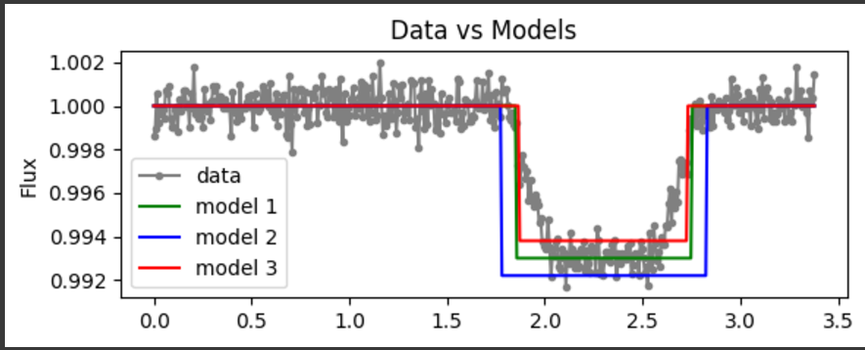
Process
Select data set from NASA Exoplanet Archive
Find timeframe in the data that displays evidence of an active transit
Create shape of a light curve that best fits the data

Slide 5
Analysis
Clear drop in brightness, meaning an exoplanet is in orbit
Can now determine radius

Slide 6
Conclusions
One of the most efficient way to locate and measure exoplanets
Compared to other methods, there are fewer risks for error and the process itself is relatively straightforward

